Slide 1
Book Recommendation
Group 2

Slide 2
Participants
Mr. Vipin Sanjay Warulkar.
Mrs. Priyanka Junj
Mr Abhinav Raja
Mr. Kagitha Manish Kumar
Mr. Venkatesh Pabbati
Manvesh Dadasaheb Karande
Atharva Vijay Kamodkar
Mentor: Karthik
Date: 1 June 2024

Slide 3
Business Objective
To Recommend books to user based Ratings and other features as well.
To understand user ratings and get insights on popular books
The use the insights for better books sales.
To get insights on popular book Authors
To help platforms of book reading community suggest better books.

Slide 4
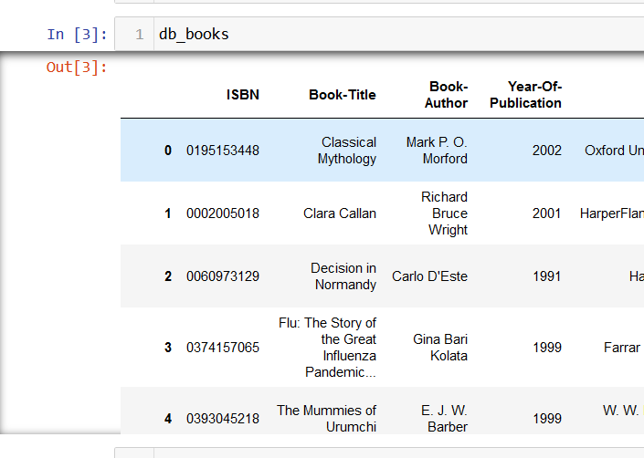
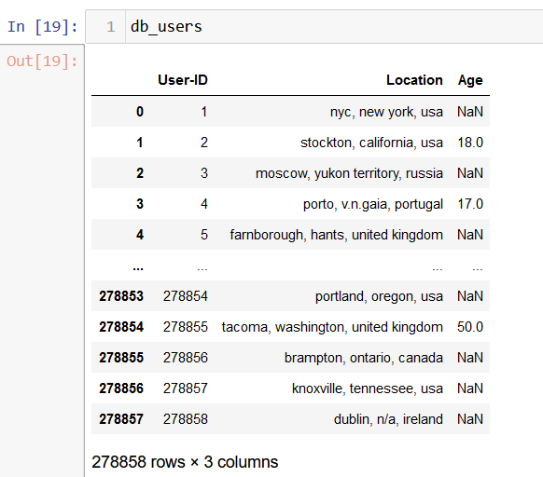
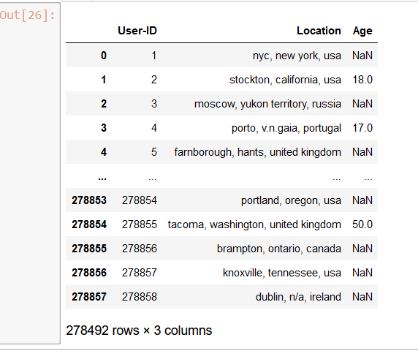
Data
We have 3 Data files: Users, Books and Ratings

Slide 5
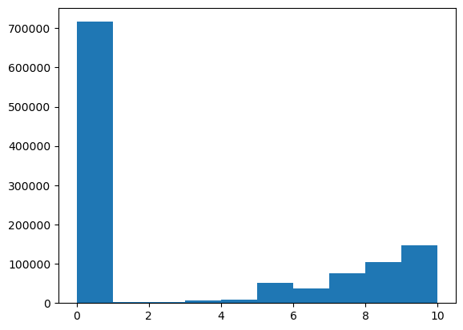
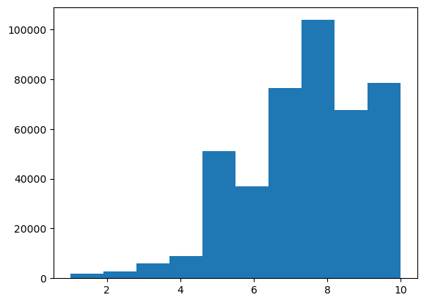
Data Cleaning
Ratings Data set has around 7000 rows where rating is 0. Hence we will remove it as these ratings are not present and will impact the recommendation system.
Before
After

Slide 6
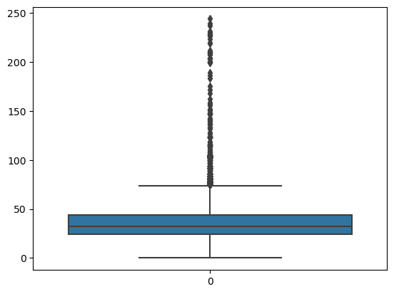
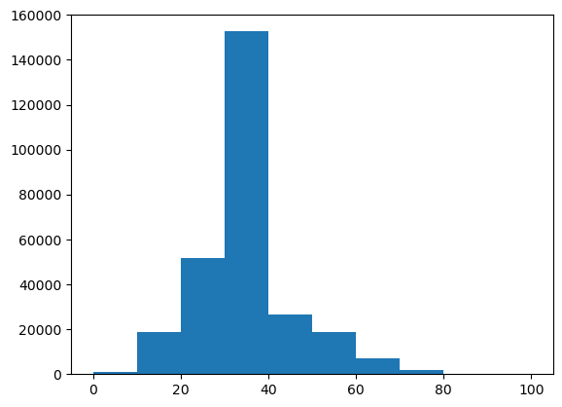
In users Data set we can plot a box blot to see the age distribution and we observe that there are many outliers present. We can see outliers above 75 but we will consider till 100 for practical reasons.
Distribution After Removing age above 100

Slide 7
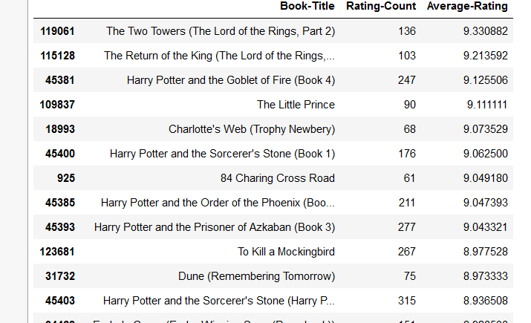
Recommendation Based on Popularity
We try to find top 200 Books based on average ratings by users. We merge Books and Ratings data set and sort the Top 50 Books based on average ratings. We have only considered books which have been rated more than 50 times at least.

Slide 8
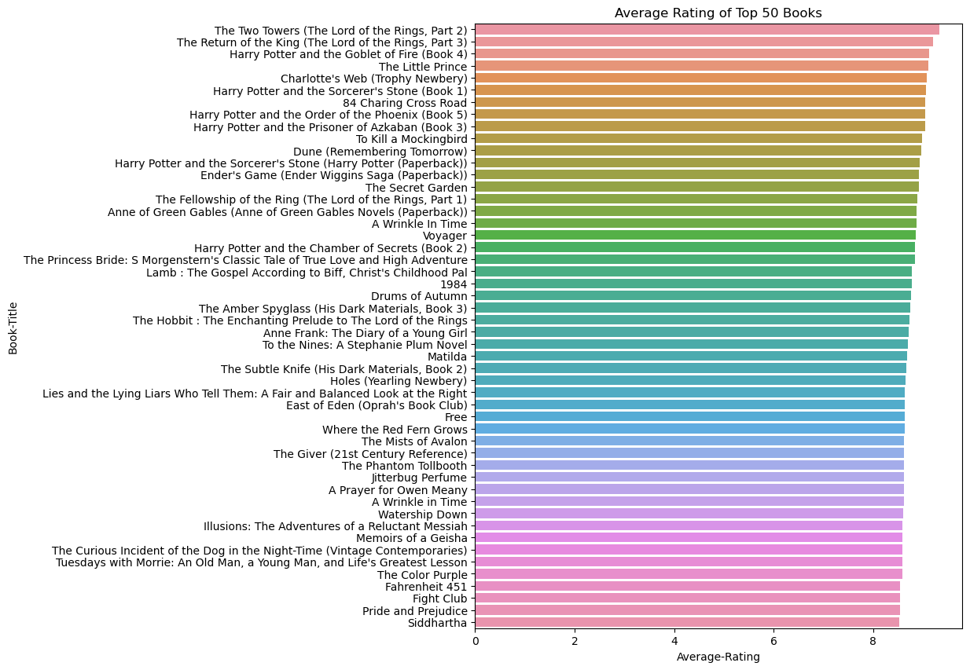
Here is the graph showing top 50 Books based on highest average ratings.

Slide 9
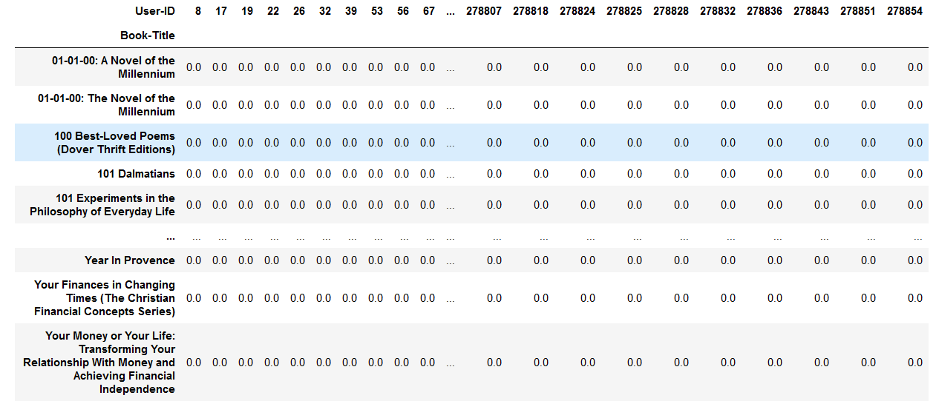
Recommendation System based on Collaborative Filtering
Here we have considered only the books which have more than just 1 Rating. We have created a pivot with books as rows and users as columns

Slide 10
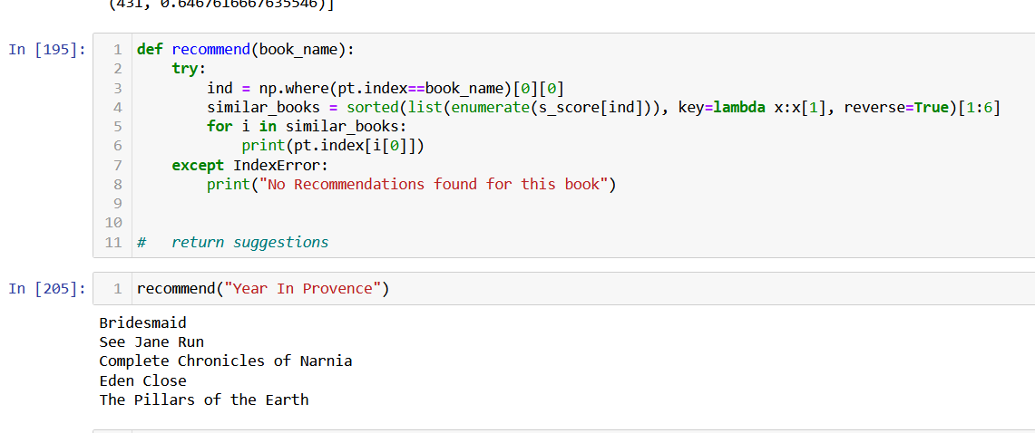
We create a function based on similarity score where user enters a book and will get book recommendations.

Slide 11
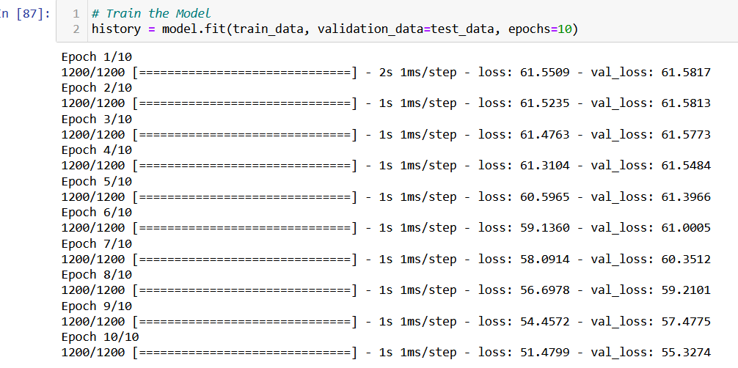
Recommendation using Google Tensorflow
Created database with user-id, book-id and ratings.
Create 2 other columns with unique user-id’s and unique book-id’s.
Change database to tensorflow slices.
Create training data and train the model.

Slide 12
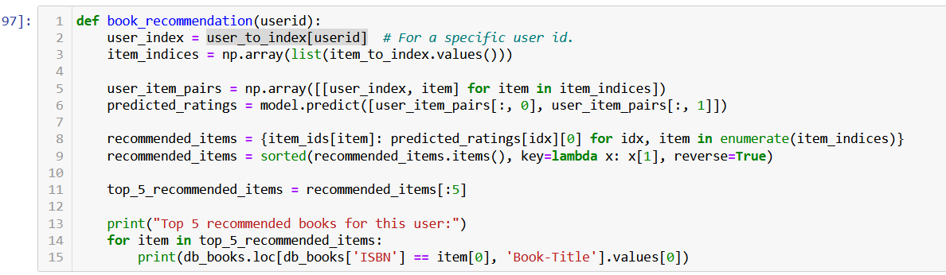
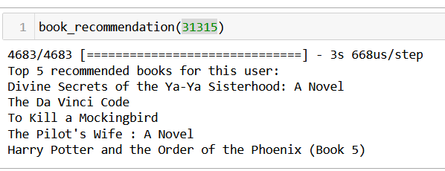
Create function to show recommended books based on entered user id. 5 Books are recommended.

Slide 13
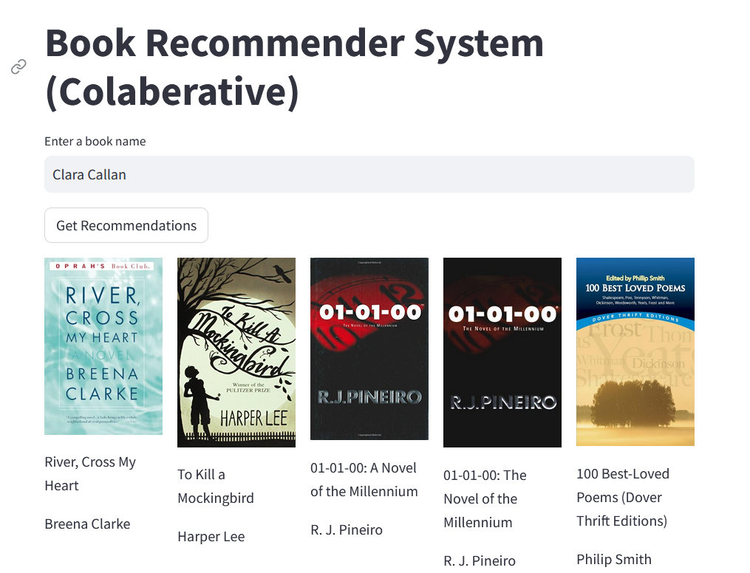
Deploying the Model (Collaborative)
Deploy the model using streamlit. Enter Book Title to get book recommendations.

Slide 14
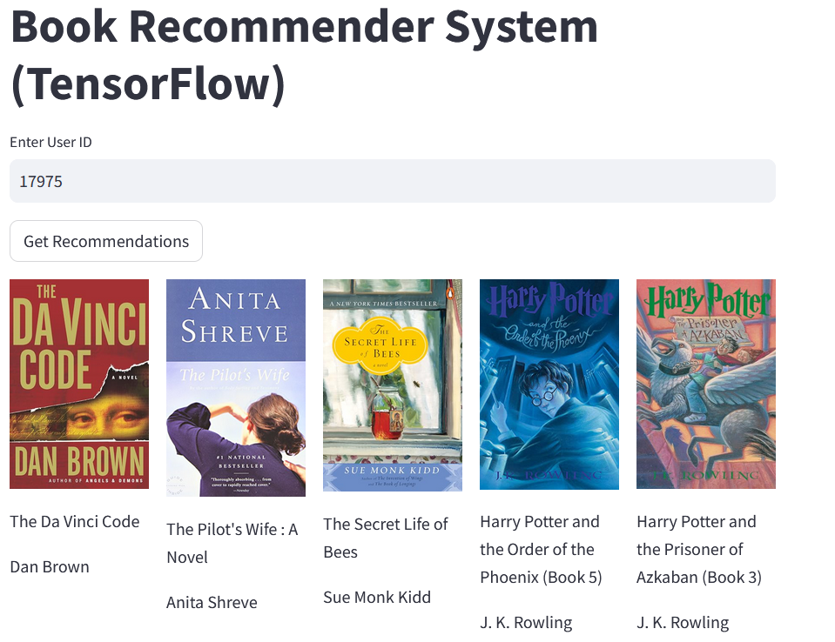
Deploying the Model (TensorFlow). Enter User-id to get recommended books.

Slide 15
Challenges
Cleaning data: Lot of missing values and many outliers were present. So filtering data based on practicality was bit challenging.
Recommending books with Collaborative: Using cosine similarity not all the books are covered in the recommended system. Hence many books are not shown for similar/recommended books.
Tensorflow System: The library uses data which is already in tensor format so for a pandas dataframe the data had to be converted into tensor format.
Having a stable version of tensorflow which works well with the given version of python as not all updated versions of python work well with tensorflow.
Deploying model using tensorflow: As we have used custom subclasses for tensorflow we had to implement call function as well.
Saving and loading model for deployment with correct format so we can use in deployment as the h5 format was giving error.
Saved model is very large in size and also running in local system was time consuming.

Slide 16
THANK YOU

